Slide 1
Joe’s Avocados
Grown in California

Slide 2
WUSATA SAMPLE ONLY
WUSATA SAMPLE ONLY

Slide 3
WUSATA SAMPLE ONLY
Avocados are healthy and nutritious
Super cancer fighter
Can lower cholesterol levels
Good for your heart, eyes, and liver
Loaded with fiber, potassium, and vitamins
WUSATA SAMPLE ONLY

Slide 4
WUSATA SAMPLE ONLY
WUSATA SAMPLE ONLY

Slide 5
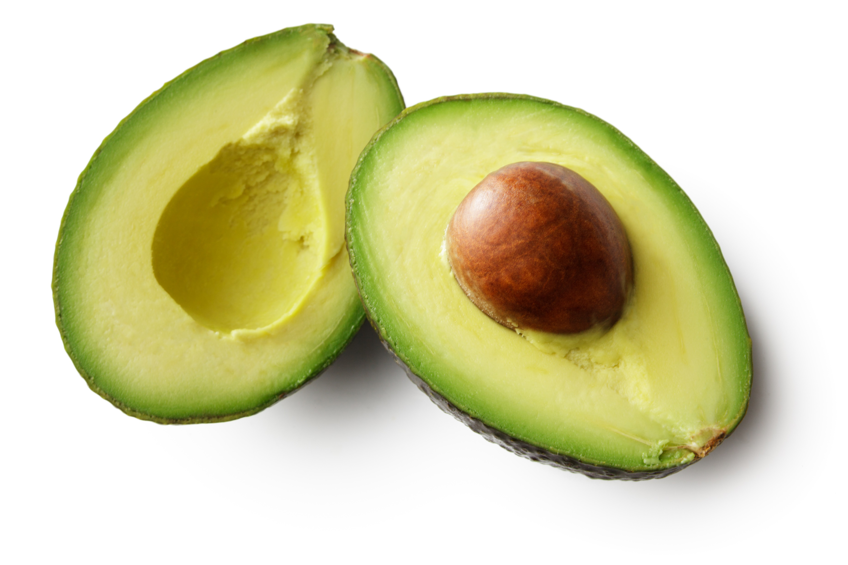
WUSATA SAMPLE ONLY
Joe’s Avocados
Find them in your local food stores
Product of the USA
WUSATA SAMPLE ONLY

